Slide 1

YouTube Clone
By – Aayush Sharma & Vaibhav Gupta
PHP , MY SQL , Python , Django , HTML , CSS , JS
Used:

Slide 2
01
INTRODUCTION
CONTENTS
02
ER DIAGRAM
03
NORMALISATION
04
SCREENSHOTS
05
CONCLUSION

Slide 3
INTRODUCTION
YouTube is an American online video-sharing platform headquartered in San Bruno, California. Three former PayPal employees-Chad Hurley, Steve Chen, and Jawed Karim—created
the service in February 2005. Google bought the site in November 2006 for US 1.65 billion;
YouTube now operates as one of Google’s subsidiaries.
Since YouTube works on such a massive scale, we decided to use this as an inspiration for the
project. YouTube’s database schemas are one of the most complicated ones currently being
scaled and used massively impacting billions of users! YouTube allows users to upload, view,
rate, share, add to playlists, report, comment on videos, and subscribe to other users. It
offers a wide variety of user-generated and corporate media videos.

Slide 4
01
CSS
02
PHP
TECHNOLOGIES
03
Apache
04
MySQL
05
Django
06
Java Script

Slide 5
01. Features
In our implementation of the popular video streaming service, we have incorporated the following features for our web application
Upload & Delete
Personal Account
Users must be able to upload/delete videos in the system when they log in.
Users must be able to create a personal account.
Add Comments
Own Personal account page
Users must be able to add comments to videos in the system when they log in.
Each registered user must have their own personal account page.
Watch Videos
Login and logout
Users must be able to watch videos in the system when they log in or logout.
Users must be able to log in to the system and logout from the system.
Search videos, users, groups
Create Channels
Users must be able to search for videos/users/groups when they log in or logout.
Users must be able to create channels.

Slide 6
CONTINUED
In our implementation of the popular video streaming service, we have incorporated the following features for our web application
Like/Dislike Videos
Users must be able to Like or Dislike the videos
Watch History
Users must be able to check the watch history
Watch Videos
Users must be able to watch videos in the system when they log in or logout.
Search videos, users, groups
Users must be able to search for videos/users/groups when they log in or logout.

Slide 7
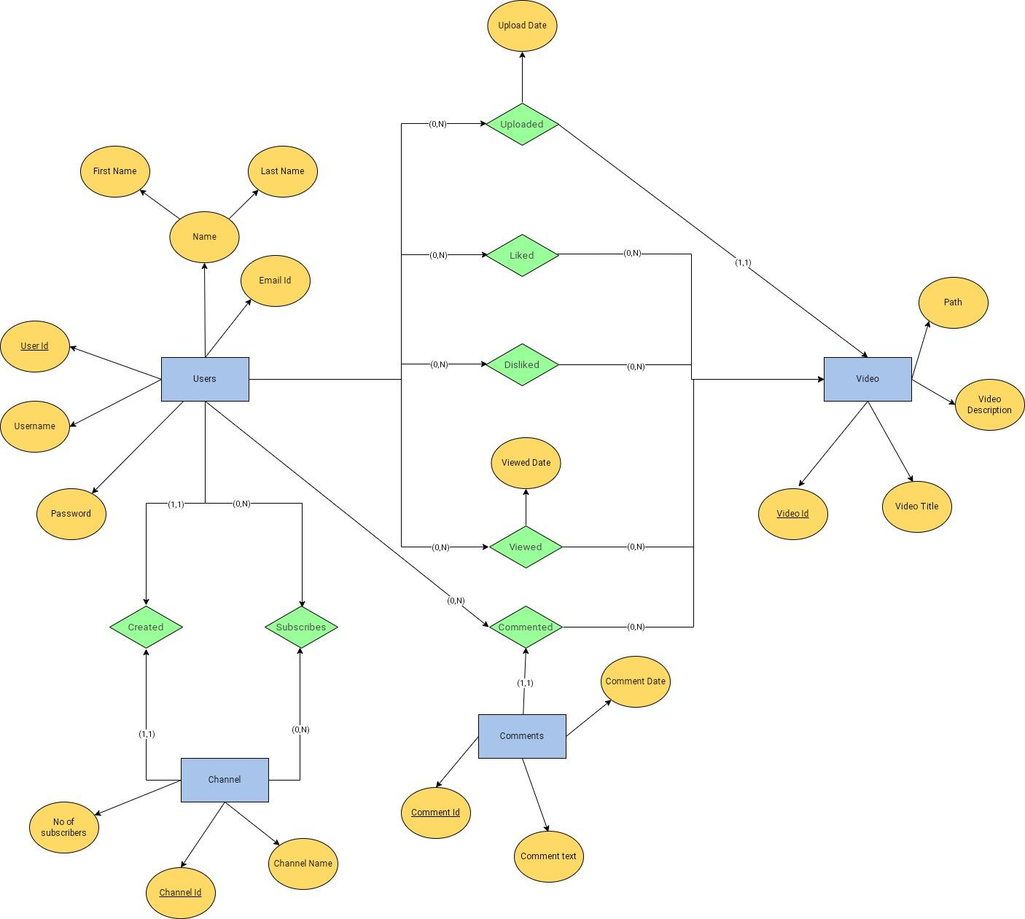
02 . ER Diagram

Slide 8
Relationship Types
Uploaded : Upload Date/Time : Binary 1:N relationship between User and Video
Liked : Binary M:N relationship between User and Video
Disliked : Binary M:N relationship between User and Video
Viewed : Viewed Date/Time : Binary M:N relationship between User and Video
Commented : Ternary relationship between Comment, User and Video
Created : Binary 1:1 relationship between User and Channel
Subscribes : Binary M:N relationship between User and Channel

Slide 9
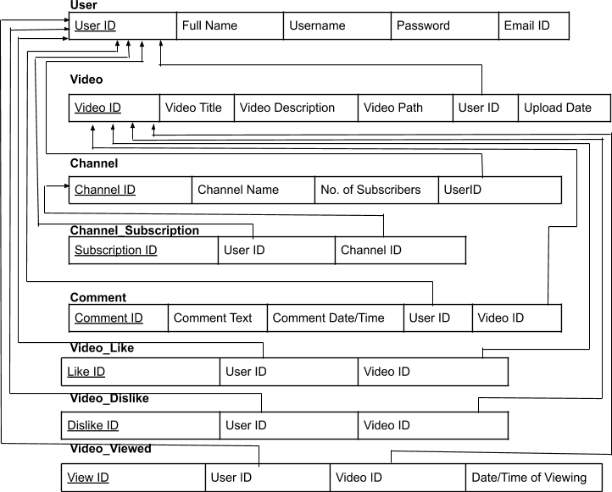
Conversion of ER to Relational Schema

Slide 10
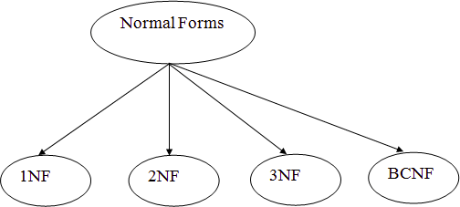
03 . Normalization
Introduction
Normalization is the process of organizing the data in the database. It is used to minimize the redundancy from a relation or set of relations. Normalization divides the larger table into the smaller table and links them using relationship. The normal form is used to reduce redundancy from the database table.
Types and their description
There are four types of Normal Forms
行业PPT模板http://www.1ppt.com/hangye/

Slide 11
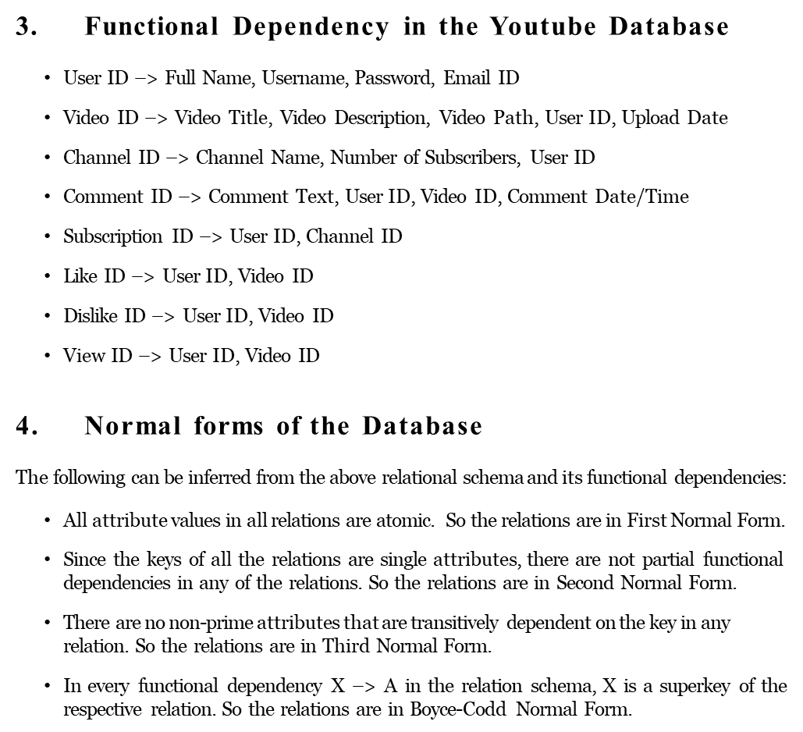
Continued

Slide 12
04
SCREENSHOTS

Slide 13
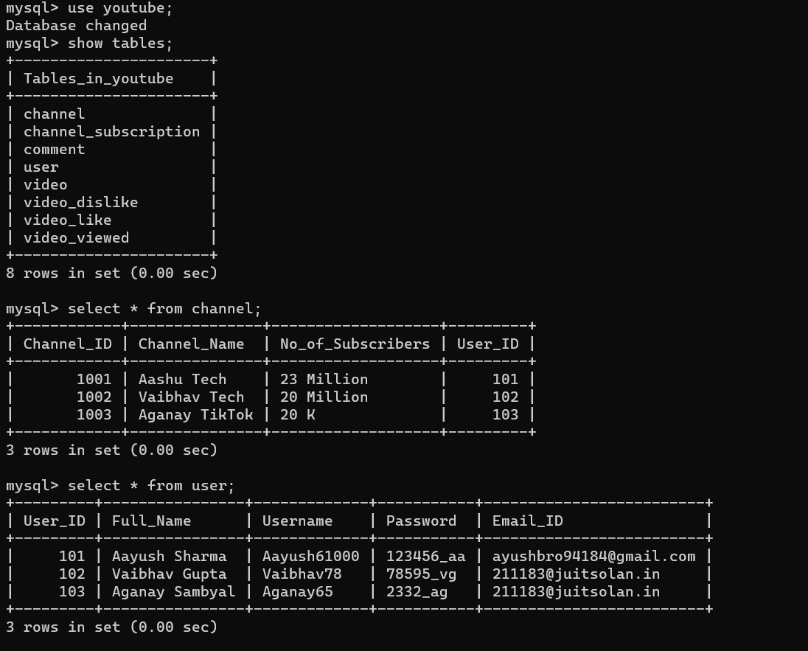
Creating Database And Making Tables

Slide 14
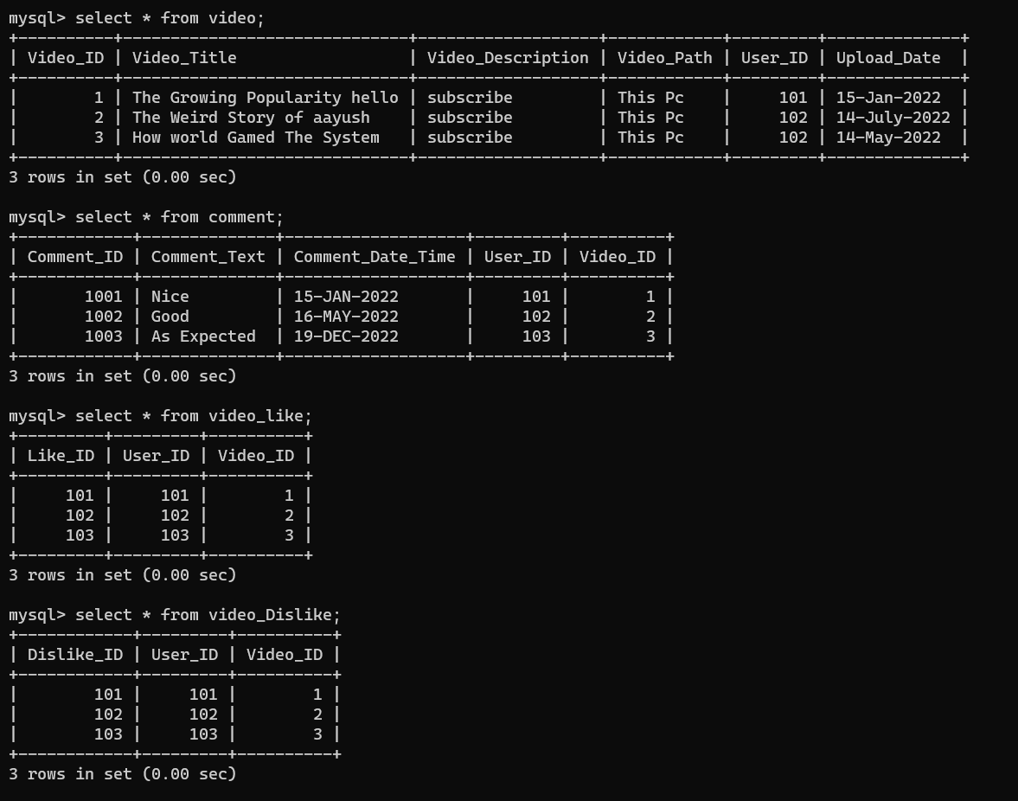
Continued

Slide 15
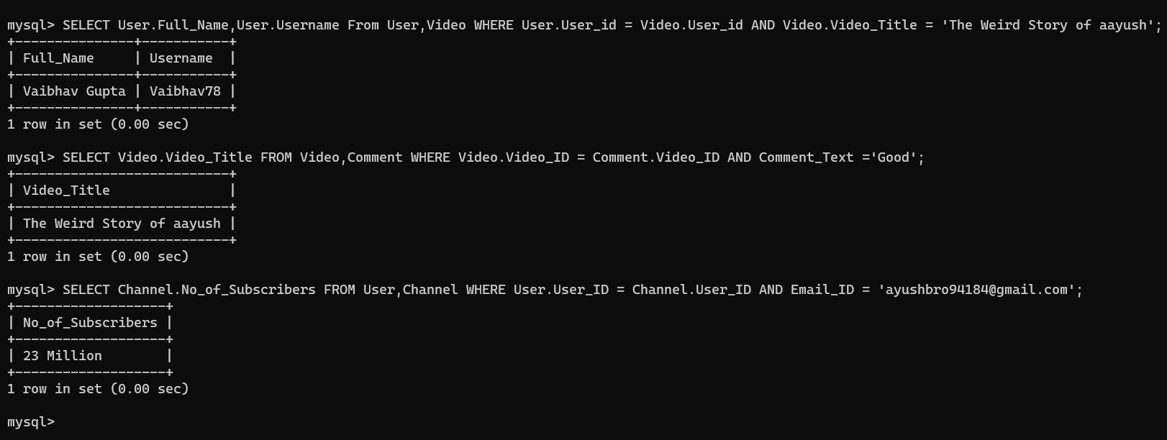
Running Queries

Slide 16
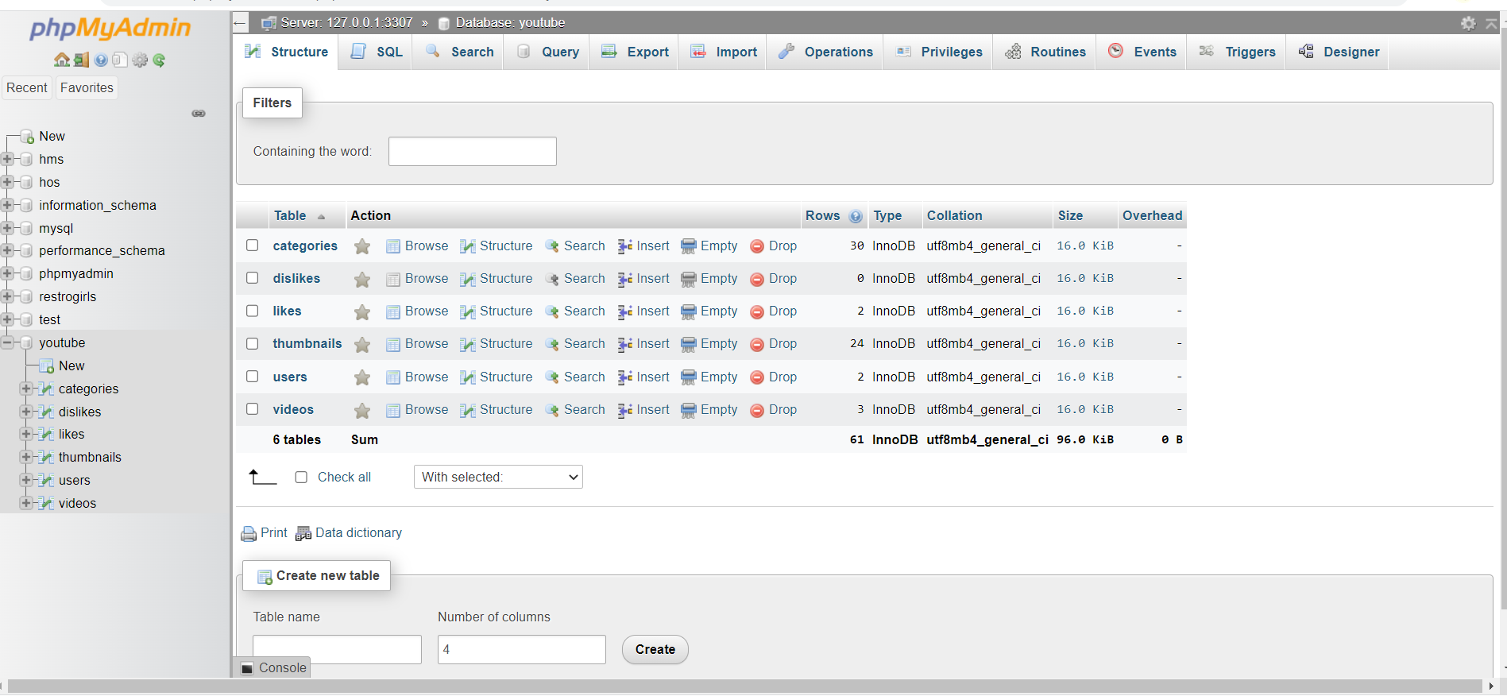
Linking Database With Xampp

Slide 17
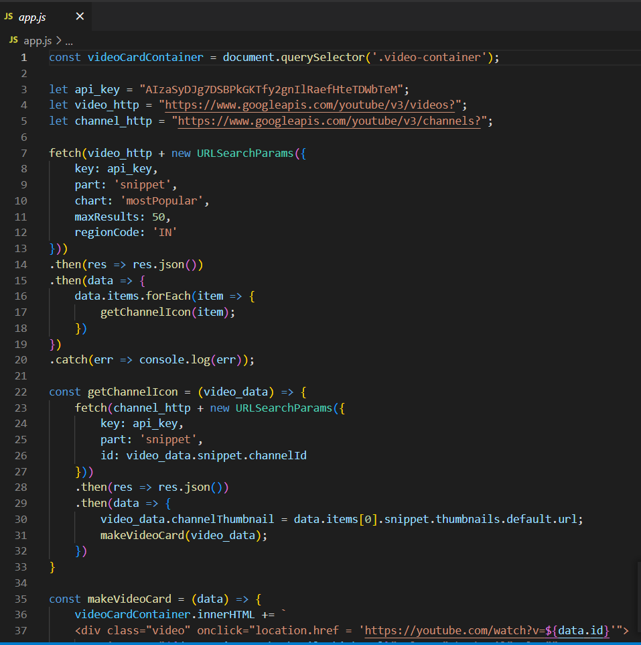
Java Script Code

Slide 18
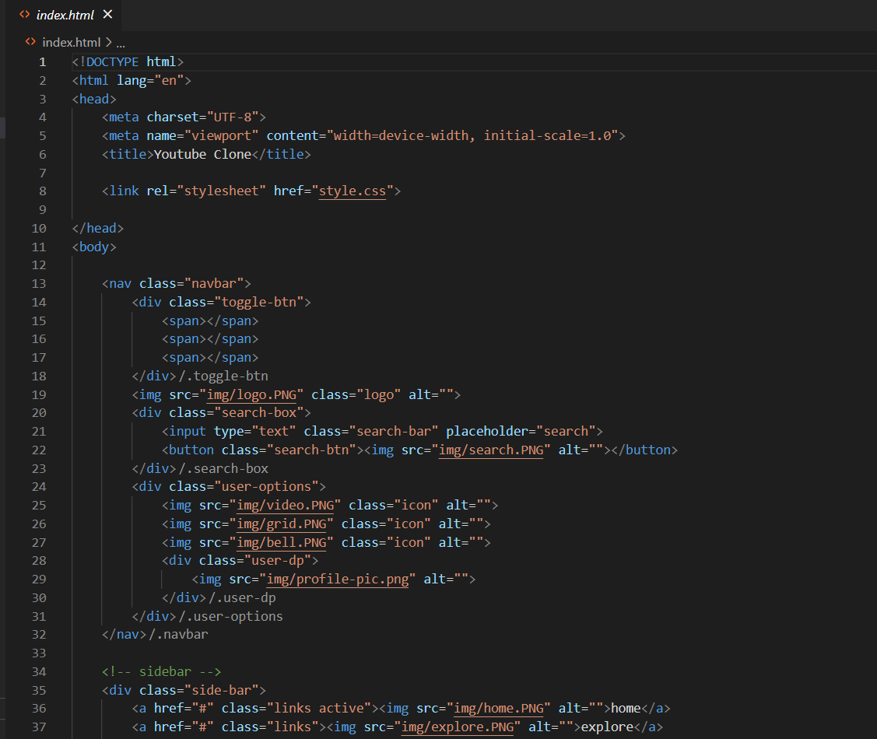
HTML Code

Slide 19
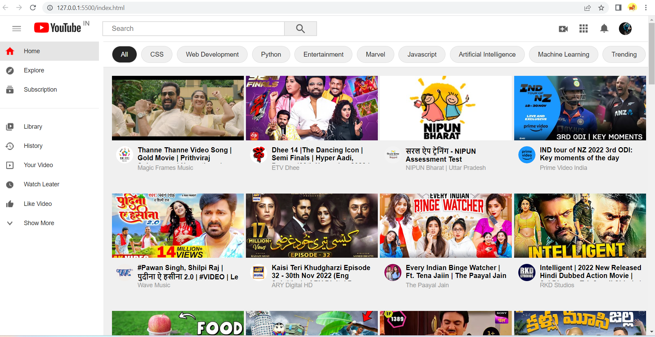
Final Output

Slide 20
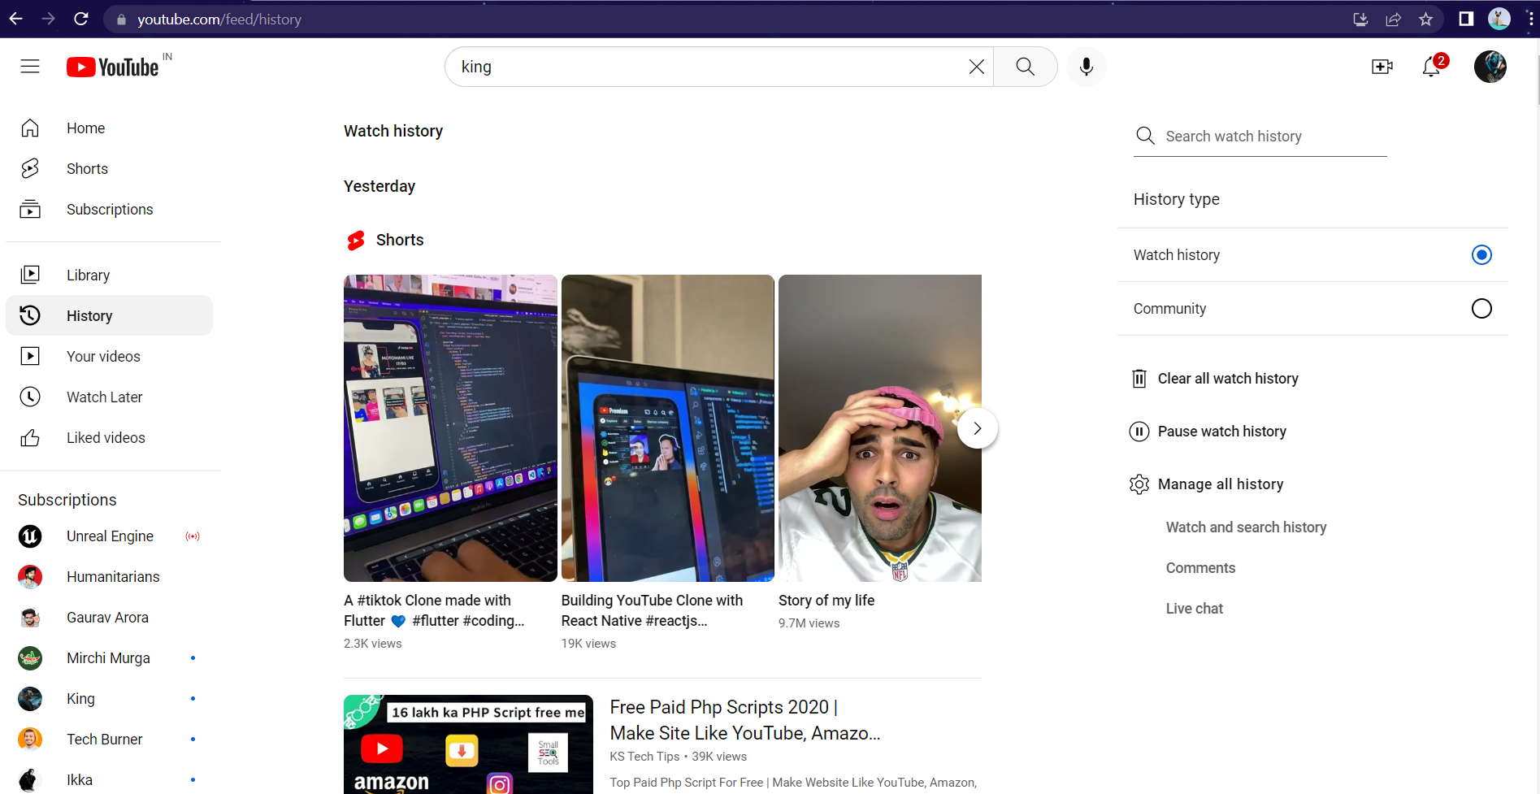
All Buttons Working

Slide 21
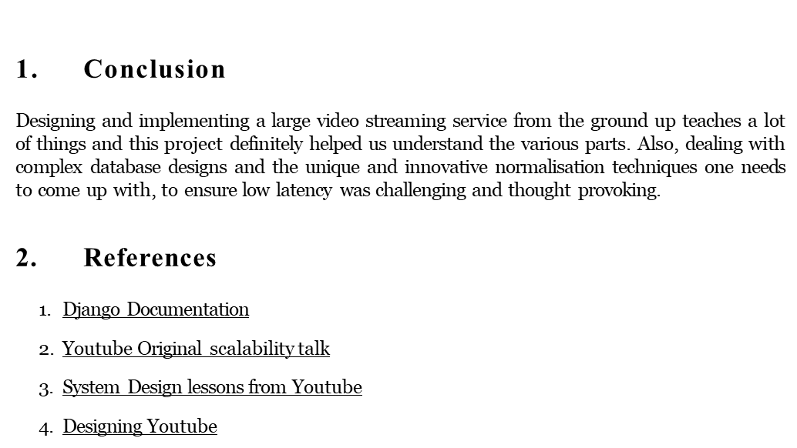
05 . Conclusion And References

Slide 22
Thank you

